Slide 1
Breast Cancer Prediction
OASIS ANALYTICS
16/01/2023

Slide 2
AGENDA
Project Recap
Problem
Meet The Team
Process
Workflow
Insights
Model Development
Results
Business Benefit
Summary

Slide 3
Project recap
PRIMO Cancer Research Institute (PCRI) is a non-profit organization dedicated to studying and understanding the biology of cancer, developing new treatments and therapies, and improving the lives of those affected by the disease.
Oasis Analytics has been tasked with developing a Machine Learning Model for Primo Cancer Research Institute to help their researchers improve the accuracy of their cancer diagnosis and prognosis.
The expectations are:
Create meaningful insights and visuals using the FNA dataset.
Develop a ML model with high accuracy and precision.

Slide 4
Problem
Currently, PCRI uses three techniques to detect Breast Cancer:
Mammography (65% to 98% correctness)
FNA (Fine Needle Aspiration) with visual interpretation (65% to 98% correctness)
Surgical biopsy (approximately 100% correctness).
Mammography and FNA with visual interpretation correctness varies widely, and the surgical biopsy, although reliable, is invasive and costly.
How can researchers at PCRI improve the accuracy of cancer diagnosis and prognosis, and ultimately develop more effective treatments for patients?

Slide 5
Meet THE team

Slide 6

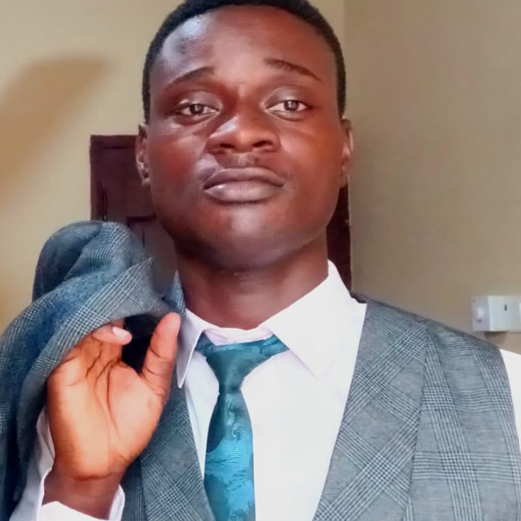

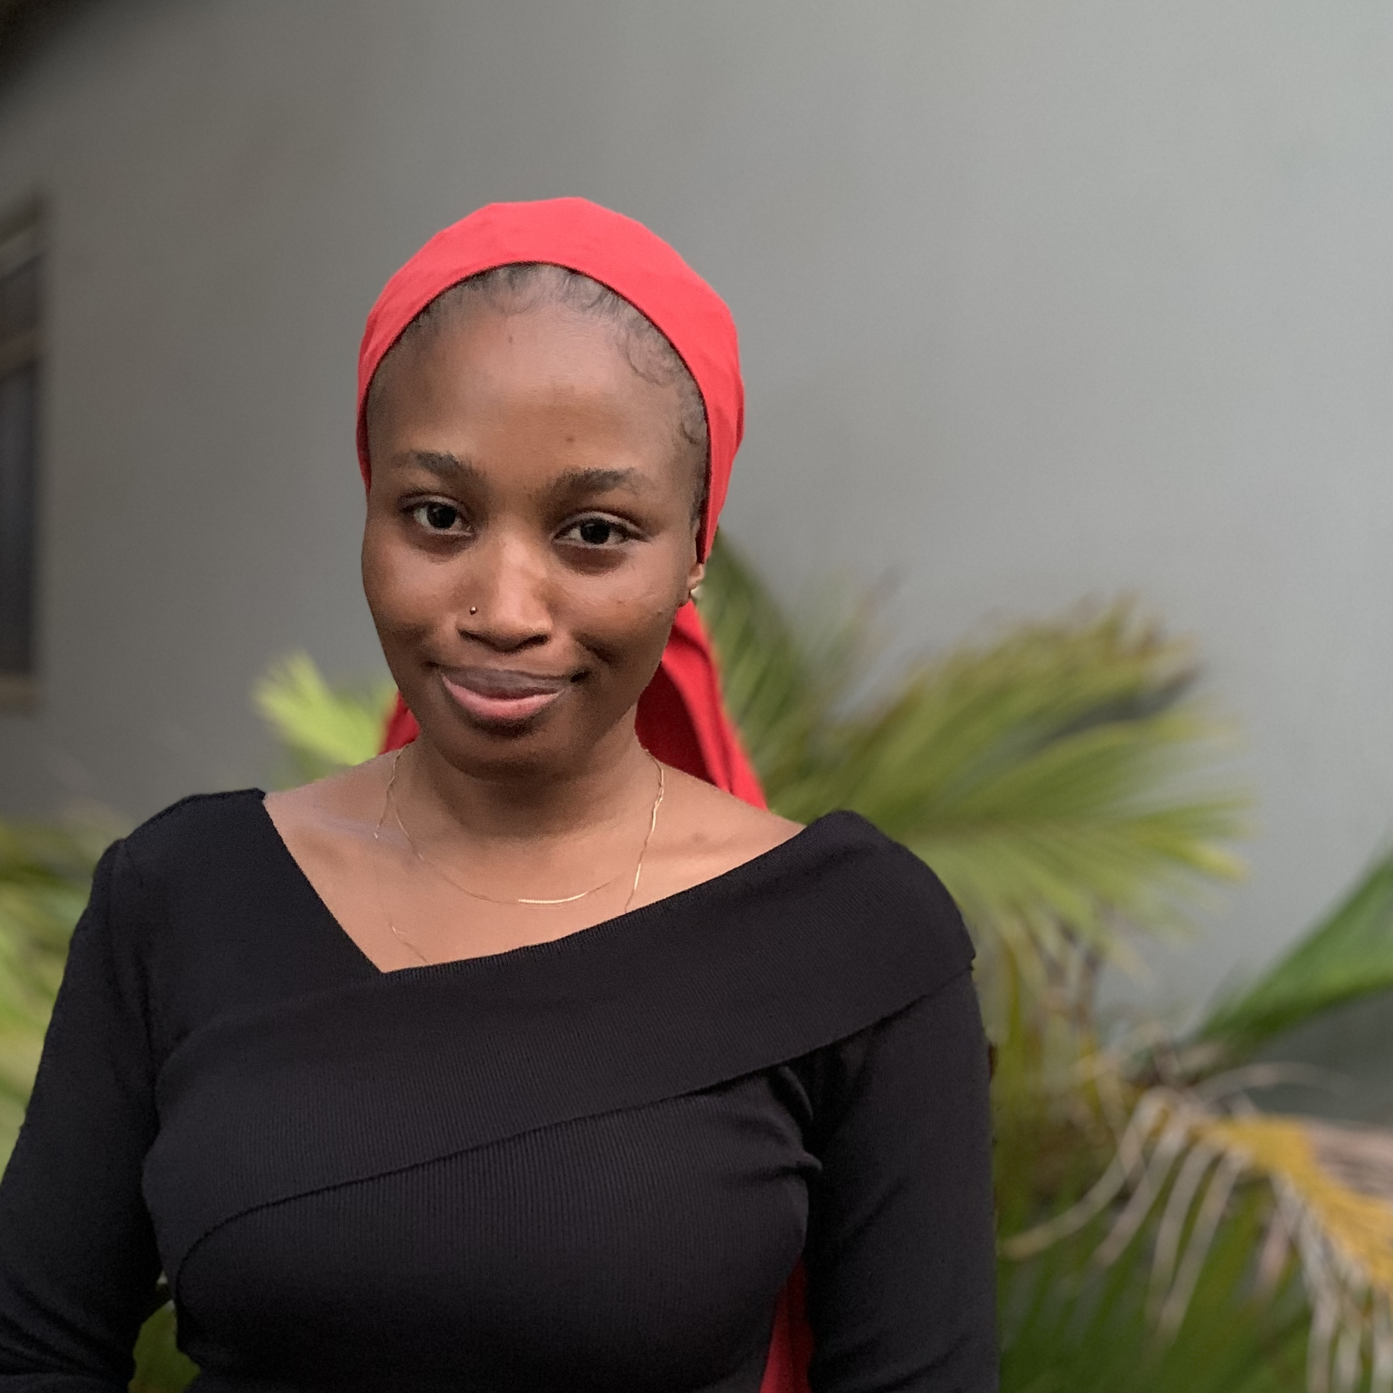


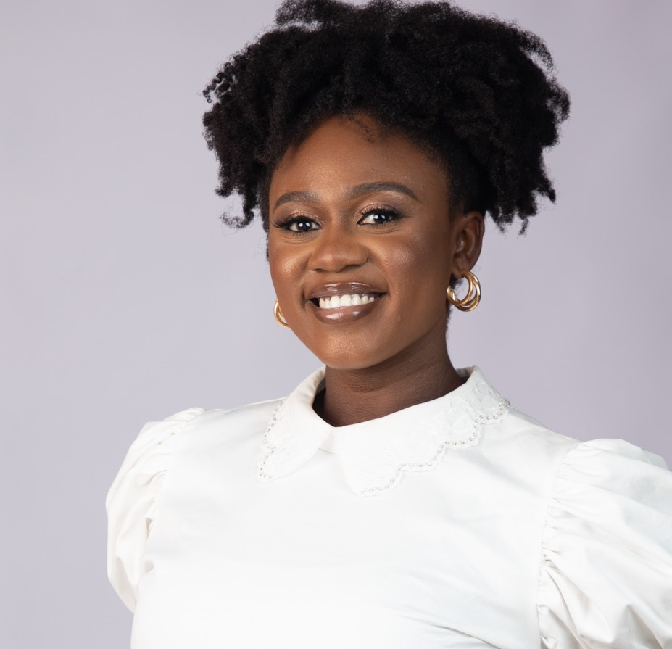

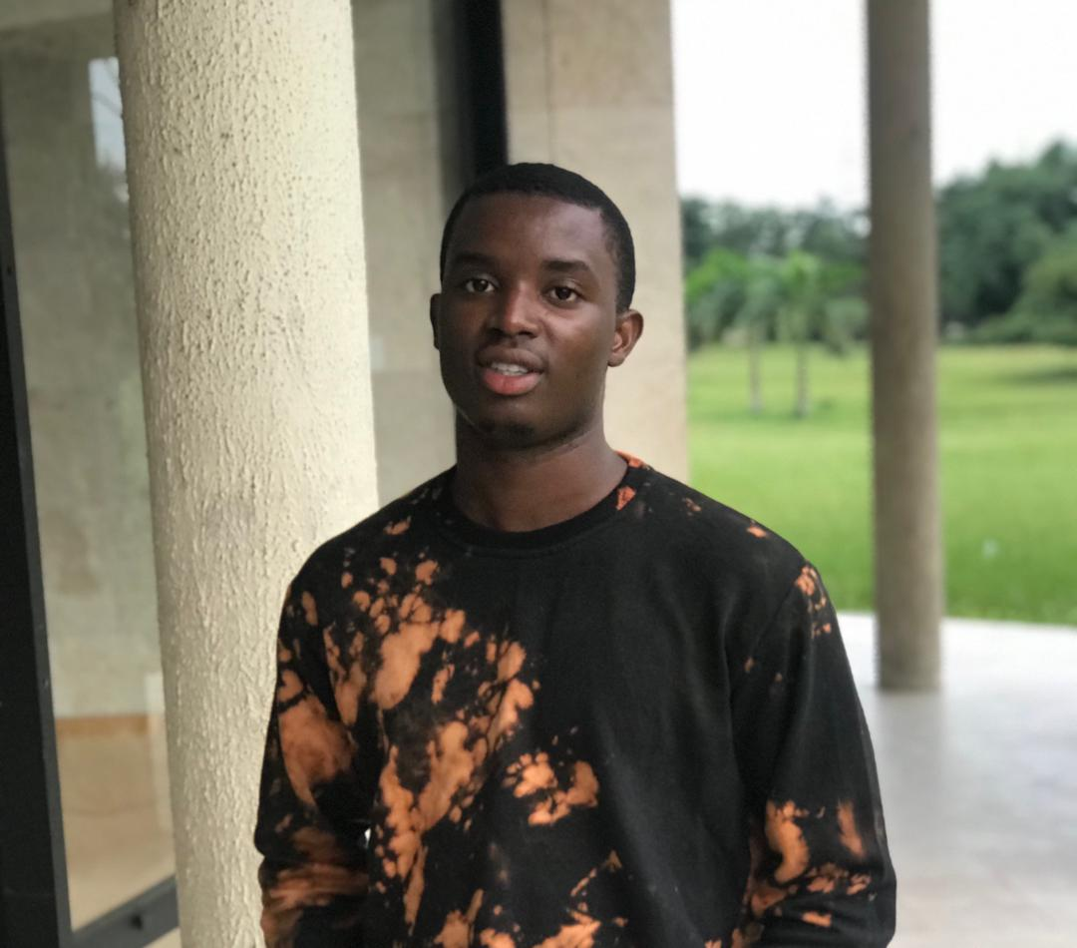
Data engineering
JOHN ALABI
RUTHERFORD BRANDFUL
Data analytics
EZRA MANUEL
MOBOLAJI ADEJONRIN
CHIEBUKA OKORO
ROHULLAH OLUWATOBI ETTU
Data science & Machine learning
NANCY ARMAH
DENGIMOWEI ALABINTEI
SAMUEL OBE

Slide 7
PROCESS
1
Business Problem Understanding
2
Source Data
3
Create Database and Load Data
4
Data Modelling
5
Data Analysis & Visualization
6
Generate Insights
7
Model Development

Slide 8




WORKFLOW
Transform
Structured Data
Extract from data source
Load into database
Connect Jupyter Notebook

Slide 9
INSIGHTS
100%
30
569
Of observations are non-null values
Unique Attributes
Observations

Slide 10
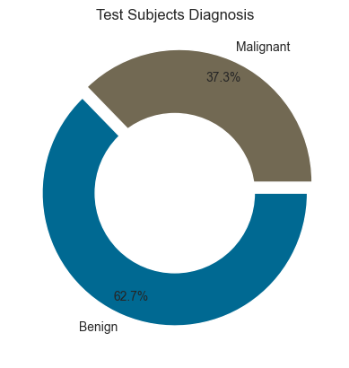
Diagnosis is split into Benign (B) and Malignant (M)
357 (62.7%) records/observations are captured for Benign cells
212 (37.3%) records/observations are captured for Malignant Cells

Slide 11
MODEL DEVELOPMENT
MODELS USED
TRAINING
EVALUATION
Logistic Regression
Random Forest
K-Nearest Neighbors (KNN)
Support Vector Machine (SVM)
Model trained on 80% of the data.
Model tested on 20% of the data.
Model trained on all features.
Model trained on best 10 features.​​​
Metrics used;
Accuracy
Confusion Matrix
Classification Report

Slide 12
RESULTS
Models Trained on all Features
Models Trained on best 10 Features
Model | Accuracy
Logistic Reg. | 98.2%
SVM | 98.2%
KNN | 96.5%
Random Forest | 96.5%
Model | Accuracy
Random Forest | 96.5%
KNN | 95.6%
Logistic Reg. | 94.7%
SVM | 94.7%

Slide 13
BUSINESS BENEFIT
Improved patient outcomes
Increased efficiency
Reduced healthcare costs
Improved patient experience
Competitive edge
Research

Slide 14
SUMMARY
The goal of this project was to develop a Machine Learning Model with a high accuracy and precision and Logistic Regression and SVM have both achieved an accuracy of 98.2%.
This represents a major step forward in the fight against cancer and has the potential to greatly assist physicians in making accurate and timely diagnoses.
We look forward to further testing and implementing this model in clinical settings to help improve patient outcomes.

Slide 15
THANK YOU

